Slide 1
CS 5402 Introduction to Data Mining
Data Mining Methods - Perceptron Regression
v.1.0
Perry B. Koob, koobp@mst.edu

Slide 2
What we are going to learn.
Perceptron
Perceptron Regression

Slide 3
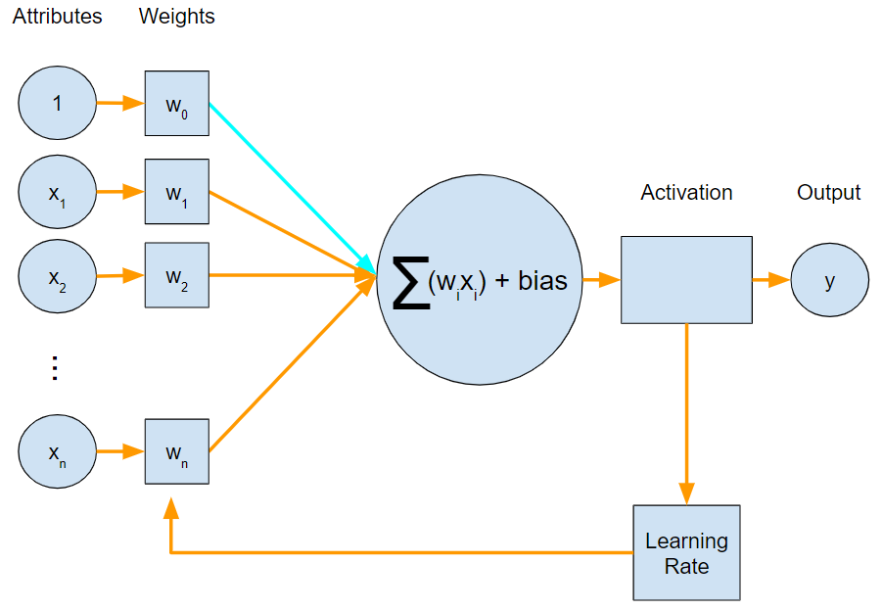
Perceptron

Slide 4
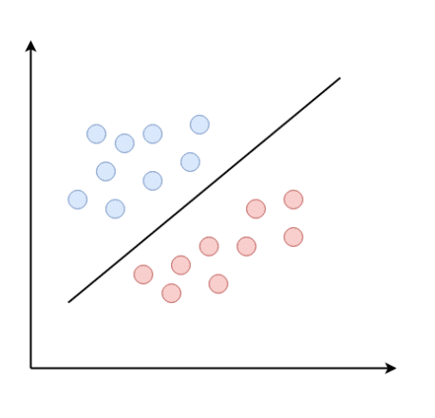
Perceptron Regression
The Perceptron comes from Frank Rosenblatt in 1958.
Perceptrons work as a classification system only if the classes are linearly separable.
https://magoosh.com/data-science/what-is-perceptron/

Slide 5
Perceptron Regression

Slide 6
Perceptron Regression
Attributes
Interval or Ratio attributes from our data, one example at a time.
1
x₁
x₂
.
.
.
x_{n}
X =

Slide 7
Perceptron Regression
Weights
The weights are initially set to all zeros.
We will run all the training examples through the perceptron and adjust the weights depending on if they properly classify the training examples.
w₀
w₁
w₂
.
.
.
w_{n}
W =

Slide 8
Perceptron Regression
Attributes * Weights
A*W
1
x₁
x₂
.
.
.
x_{n}
w₀
w₁
w₂
.
.
.
w_{n}
X
[w₀, a₁ * w₁, a₂ * w₂, … , a_{n} * w_{n}]

Slide 9
Perceptron Regression
Summation Function
[w₀, a₁ * w₁, a₂ * w₂, … , a_{n} * w_{n}]
1 * w₀ + a₁ * w₁ + a₂ * w₂ + …+ a_{n} * w_{n}

Slide 10
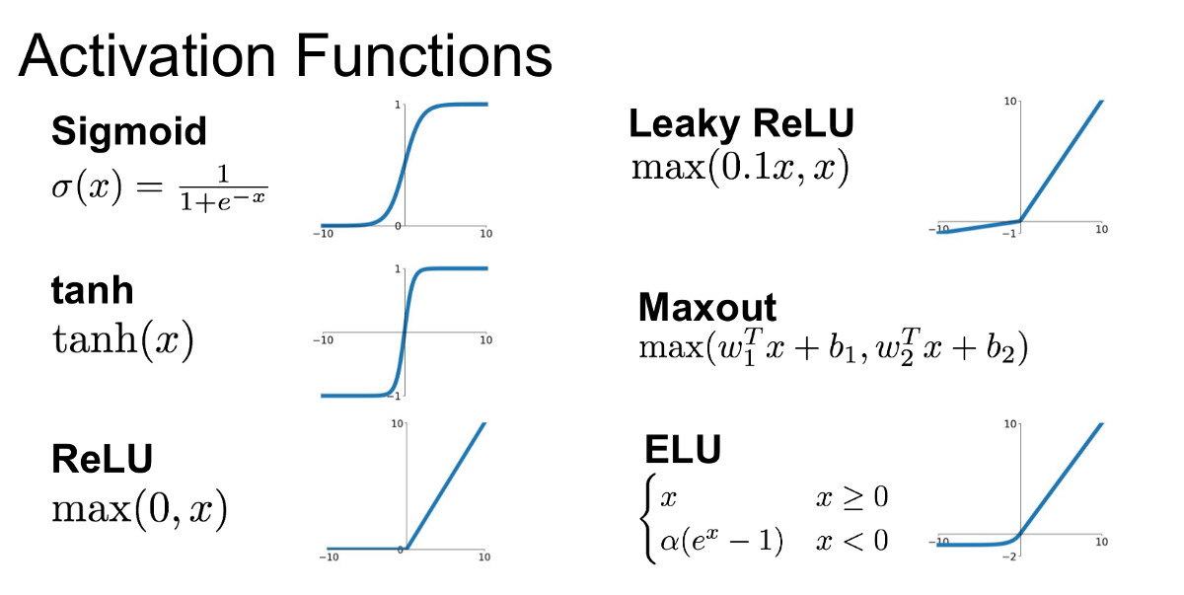
Perceptron Regression
Activation
The Activation Function turns the values from the sums into a classification. You can also use a threshold. If you are performing Numeric Prediction, you can also use no Activation function.
Stepwise
1 x >
0 x < Θ

Slide 11
Perceptron Regression
Learning Rate
For Perceptron Regression we don’t have a learning rate, we use the attributes.
If the Perceptron INCORRECTLY Classifies the example and the example is belongs to the First Class, then you add the examples attributes.
If the Perceptron INCORRECTLY Classifies the example and the example is belongs to the Second Class, then you subtract the examples attributes.

Slide 12
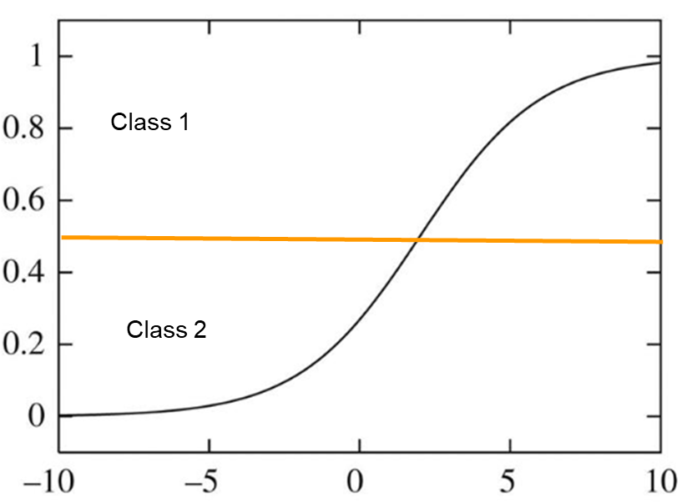
Perceptron Regression
Learning Rate
For Perceptron Regression we don’t have a learning rate, we use the attributes.
If the Perceptron INCORRECTLY Classifies the example and the example is belongs to the First Class, then you add the examples attributes.
If the Perceptron INCORRECTLY Classifies the example and the example is belongs to the Second Class, then you subtract the examples attributes.

Slide 13
Perceptron Regression
We run through the entire set of examples adjusting the Perceptrons weights with each example.
The we run through the entire set of examples, until the Perceptron “converges”. This means that it classifies all the examples in the data set correctly and we do not adjust the weights.

Slide 14
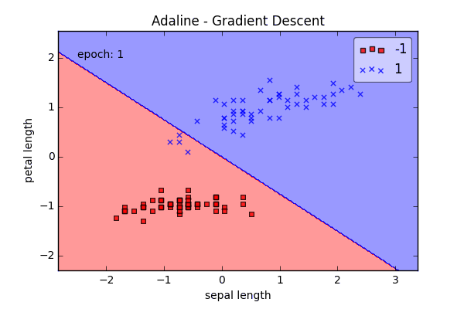
Perceptron Regression
https://sebastianraschka.com/Articles/2015_singlelayer_neurons.html

Slide 15
Winnowing
Winnowing is just like the Perceptron except:
The attributes are all binary
A Θ value is used as a threshold for a Stepwise Activation Function.
A ⍺ Learning Rate is use and applied to each weight depending on the individual attribute values.
If the example is incorrectly classified when the Class is supposed to be 1
The weight for each attribute that is 1 is multiplied by ⍺ to get a new weight.
The weight for each attribute that is 0 is left alone.
If the example is incorrectly classified when the Class is supposed to be 0
The weight for each and attribute that is 1 is set to 0 for Winnow, or divided by ⍺ for Winnow2 to get a new weight.
The weight for each attribute that is 0 then the weight is left alone.

Slide 16
What we covered.
Perceptron
Perceptron Regression

Slide 17
What to learn more?
For Regression take CS 5204 / STAT 5346
For Perceptrons take SYS ENG 5212

Slide 18
References
Kassambara, Realstack, Visitor, & Mann, T. (2018, March 11). Linear Regression Assumptions and Diagnostics in R: Essentials. Retrieved from http://www.sthda.com/english/articles/39-regression-model-diagnostics/161-linear-regression-assumptions-and-diagnostics-in-r-essentials/
Shmueli, G., Bruce, P. C., Yahav, I., Patel, N. R., & Lichtendahl Jr, K. C. (2017). Data mining for business analytics: concepts, techniques, and applications in R. John Wiley & Sons.
Witten, I. H., Frank, E., Hall, M. A., & Pal, C. J. (2016). Data Mining: Practical Machine Learning Tools and Techniques.

